Slide 1
INTRODUCTION TO DATA ANALYSIS
Presented by
N.M.MEHAVARTHINI
7229 Batch

Slide 2
What Is Data Analysis?
Data analysis is the practice of working with data to glean useful information, which can then be used to make informed decisions.
Data analysis can help a bank to personalize customer interactions, a health care system to predict future health needs, or an entertainment company to create the next big streaming hit.

Slide 3
Data analysis process
Identify
Collect
Clean
Analyze
Interpret

Slide 4
Types of data analysis
Descriptive analysis
Diagnostic analysis
Predictive analysis
Prescriptive analysis

Slide 5
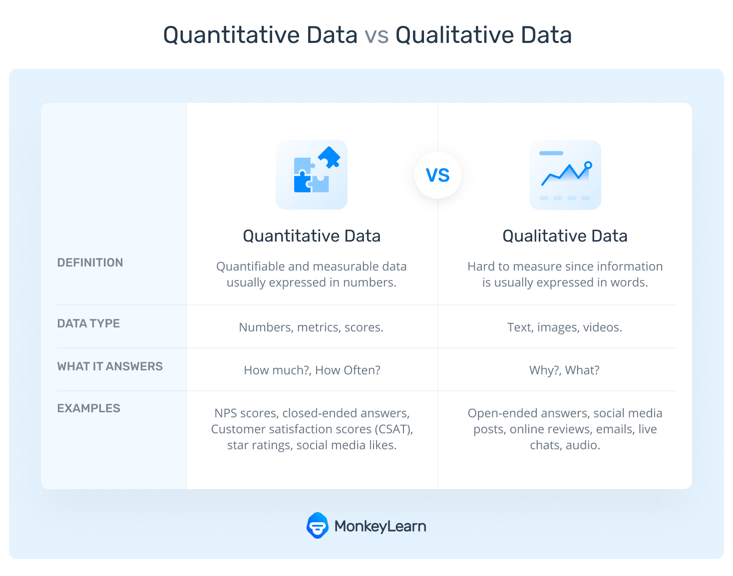
METHODS
The methods you use to analyze data will depend on whether you’re analyzing quantitative or qualitative data

Slide 6
Data analysis Advantages
Make faster and more informed business decisions backed by facts.
Identify performance issues that require action.
Gain a deeper understanding of customer requirements, which creates better business relationships.
Increase awareness of risks to implement preventive measures.
Visualize different dimensions of the data.
Gain competitive advantage.
Better understand the financial performance of the business.
Identify ways to reduce costs and thus increase profits.

Slide 7
THANK YOU

